Slide 1
Maximizing the Spread of Influence through a Social Network
Authors: David Kempe, Jon Kleinberg, Éva Tardos
KDD 2003
Adapted from author’s slide at: http://www.cs.washington.edu/affiliates/meetings/talks04/kempe.pdf

Slide 2
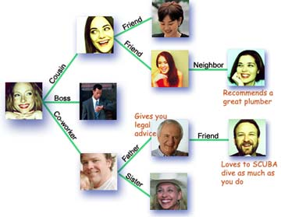
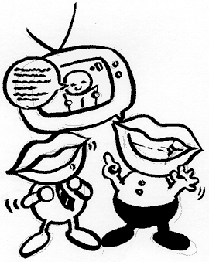
Social Network and Spread of Influence
Social network plays a fundamental role as a medium for the spread of INFLUENCE among its members
  Opinions, ideas, information, innovation…
Direct Marketing takes the “word-of-mouth” effects to significantly increase profits (Gmail, Tupperware popularization, Microsoft Origami …)

Slide 3
Problem Setting
Given
  a limited budget B for initial advertising (e.g. give away free samples of product)
  estimates for influence between individuals
Goal
  trigger a large cascade of influence (e.g. further adoptions of a product)
Question
  Which set of individuals should B target at?
Application besides product marketing
  spread an innovation
  detect stories in blogs
Notes:
if we can try to convince a subset of individuals to adopt a new
product or innovation
But how should we choose the few key individuals to use for seeding this process?
Which blogs should one read to be most up to date?

Slide 4
What we need
Form models of influence in social networks.
Obtain data about particular network (to estimate inter-personal influence).
Devise algorithm to maximize spread of influence.

Slide 5
Outline
Models of influence
  Linear Threshold
  Independent Cascade
Influence maximization problem
  Algorithm
  Proof of performance bound
  Compute objective function
Experiments
  Data and setting
  Results

Slide 6
Outline
Models of influence
  Linear Threshold
  Independent Cascade
Influence maximization problem
  Algorithm
  Proof of performance bound
  Compute objective function
Experiments
  Data and setting
  Results

Slide 7
Models of Influence
First mathematical models
  [Schelling '70/'78, Granovetter '78]
Large body of subsequent work:
  [Rogers '95, Valente '95, Wasserman/Faust '94]
Two basic classes of diffusion models: threshold and cascade
General operational view:
  A social network is represented as a directed graph, with each person (customer) as a node
  Nodes start either active or inactive
  An active node may trigger activation of neighboring nodes
  Monotonicity assumption: active nodes never deactivate
Notes:
we focus on more operational models from mathematical sociology [15, 28] and interacting particle systems
[11, 17] that explicitly represent the step-by-step dynamics of adoption.
Assumption: node can switch to active from inactive, but does not switch in the other direction

Slide 8
Outline
Models of influence
  Linear Threshold
  Independent Cascade
Influence maximization problem
  Algorithm
  Proof of performance bound
  Compute objective function
Experiments
  Data and setting
  Results

Slide 9
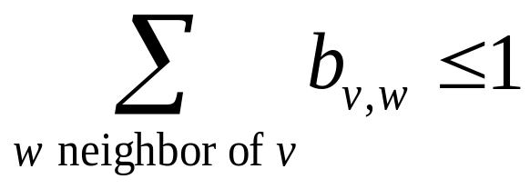
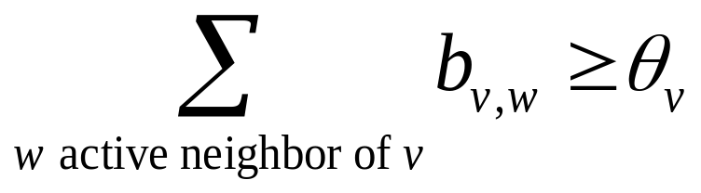
Linear Threshold Model
A node v has random threshold θ_{v} ~ U[0,1]
A node v is influenced by each neighbor w according to a weight b_{vw} such that
A node v becomes active when at least
(weighted) θ_{v} fraction of its neighbors are active
Notes:
Given a random choice of thresholds, and an initial set of
active nodes A0 (with all other nodes inactive), the diffusion process
unfolds deterministically in discrete steps: in step t, all nodes
that were active in step t-1 remain active, and we activate any
node v for which the total weight of its active neighbors is at least
Theta(v)

Slide 10
Example
Inactive Node
0.6
Active Node
0.3
0.2
0.2
Threshold
X
Active neighbors
0.1
0.4
U
0.5
0.3
Stop!
0.2
w
0.5
v

Slide 11
Outline
Models of influence
  Linear Threshold
  Independent Cascade
Influence maximization problem
  Algorithm
  Proof of performance bound
  Compute objective function
Experiments
  Data and setting
  Results

Slide 12
Independent Cascade Model
When node v becomes active, it has a single chance of activating each currently inactive neighbor w.
The activation attempt succeeds with probability p_{vw} .
Notes:
We again start with an initial set of active nodes A0, and the process unfolds in discrete steps according to
the following randomized rule. When node v first becomes active
in step t, it is given a single chance to activate each currently inactive
neighbor w; it succeeds with a probability pv;w —a parameter
of the system — independently of the history thus far. (If w has
multiple newly activated neighbors, their attempts are sequenced in
an arbitrary order.) If v succeeds, then w will become active in step
t+1; but whether or not v succeeds, it cannot make any further attempts
to activate w in subsequent rounds. Again, the process runs
until no more activations are possible.

Slide 13

Example
0.6
Inactive Node
0.3
0.2
0.2
Active Node
X
U
Newly active
node
0.1
0.4
Successful
attempt
0.5
0.3
0.2
Unsuccessful
attempt
w
0.5
v
Stop!

Slide 14
Outline
Models of influence
  Linear Threshold
  Independent Cascade
Influence maximization problem
  Algorithm
  Proof of performance bound
  Compute objective function
Experiments
  Data and setting
  Results

Slide 15
Influence Maximization Problem
Influence of node set S: f(S)
  expected number of active nodes at the end, if set S is the initial active set
Problem:
  Given a parameter k (budget), find a k-node set S to maximize f(S)
  Constrained optimization problem with f(S) as the objective function
Notes:
the influence of a set of nodes A: the expected number of active nodes at the end of the process.

Slide 16
Outline
Models of influence
  Linear Threshold
  Independent Cascade
Influence maximization problem
  Algorithm
  Proof of performance bound
  Compute objective function
Experiments
  Data and setting
  Results

Slide 17
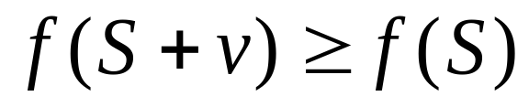
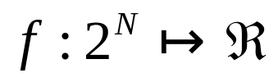
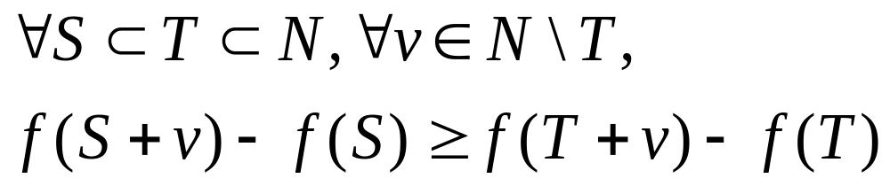
f(S): properties (to be demonstrated)
Non-negative (obviously)
Monotone:
Submodular:
  Let N be a finite set
  A set function is submodular iff
  (diminishing returns)
Notes:
A function f maps a finite ground set U to non-negative real numbers, and satisfies a natural “diminishing returns” property, then f is a submodular function.
Diminishing returns property:
The marginal gain from adding an element to a set S is at least as high as the marginal gain from adding the same element to a superset of S.

Slide 18
Bad News
For a submodular function f, if f only takes non-negative value, and is monotone, finding a k-element set S for which f(S) is maximized is an NP-hard optimization problem[GFN77, NWF78].
It is NP-hard to determine the optimum for influence maximization for both independent cascade model and linear threshold model.
Notes:
Known results:
For a submodular function f, if f only takes non-negative value, and is monotone.
Finding a k-element set S for which f(S) is maximized is an NP-hard optimization problem[GFN77, NWF78].

Slide 19
Good News
We can use Greedy Algorithm!
  Start with an empty set S
  For k iterations:
    Add node v to S that maximizes f(S +v) - f(S).
How good (bad) it is?
  Theorem: The greedy algorithm is a (1 – 1/e) approximation.
  The resulting set S activates at least (1- 1/e) > 63% of the number of nodes that any size-k set S could activate.
Notes:
The algorithm that achieves this performance guarantee is a natural greedy hill-climbing strategy
selecting elements one at a time, each time choosing an element that provides
the largest marginal increase in the function value.
f(S) >= (1-1/e) f(S*)
This algorithm approximate the optimum within a factor of (1-1/e) ( where e is the base of the natural logarithm).

Slide 20
Outline
Models of influence
  Linear Threshold
  Independent Cascade
Influence maximization problem
  Algorithm
  Proof of performance bound
  Compute objective function
Experiments
  Data and setting
  Results

Slide 21
Key 1: Prove submodularity

Slide 22
Submodularity for Independent Cascade
0.6
Coins for edges are flipped during activation attempts.
0.3
0.2
0.2
0.1
0.4
0.5
0.3
0.5

Slide 23
Submodularity for Independent Cascade
0.6
Coins for edges are flipped during activation attempts.
Can pre-flip all coins and reveal results immediately.
0.3
0.2
0.2
0.1
0.4
0.5
0.3
0.5
Active nodes in the end are reachable via green paths from initially targeted nodes.
Study reachability in green graphs
Notes:
Our proof deals with these difficulties by formulating an equivalent
view of the process, which makes it easier to see that there
is an order-independent outcome, and which provides an alternate
way to reason about the submodularity property.
From the point of view of the process, it clearly does not matter whether the
coin was flipped at the moment that v became active, or whether it
was flipped at the very beginning of the whole process and is only
being revealed now. With all the coins flipped in advance, the process can be viewed
as follows. The edges in G for which the coin flip indicated an
activation will be successful are declared to be live; the remaining
edges are declared to be blocked. If we fix the outcomes of the coin
flips and then initially activate a set A, it is clear how to determine
the full set of active nodes at the end of the cascade process:
CLAIM 2.3. A node x ends up active if and only if there is a
path from some node in A to x consisting entirely of live edges.
(We will call such a path a live-edge path.)

Slide 24
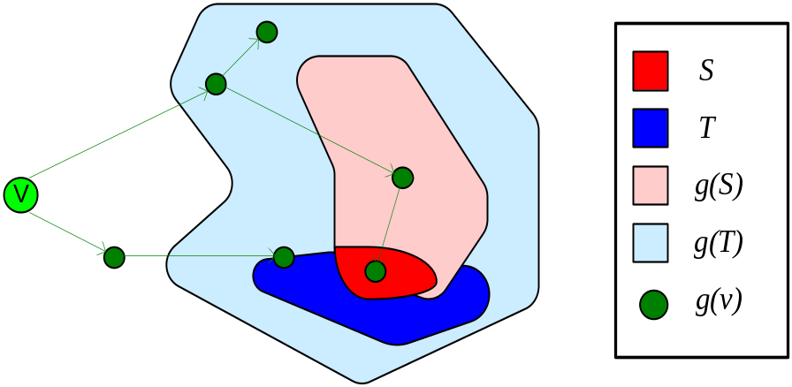

Submodularity, Fixed Graph
Fix “green graph” G. g(S) are nodes reachable from S in G.
Submodularity: g(T +v) - g(T) g(S +v) - g(S) when S T.
g(S +v) - g(S): nodes reachable from S + v, but not from S.
From the picture: g(T +v) - g(T) g(S +v) - g(S) when S T (indeed!).
Notes:
g(S +v) - g(S): Exactly nodes reachable from v, but not from S.

Slide 25
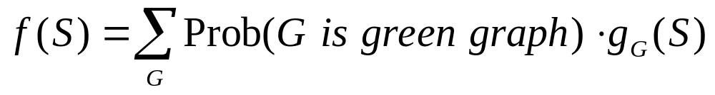
Submodularity of the Function
Fact: A non-negative linear combination of submodular functions is submodular
g_{G}(S): nodes reachable from S in G.
Each g_{G}(S): is submodular (previous slide).
Probabilities are non-negative.

Slide 26
Submodularity for Linear Threshold
Use similar “green graph” idea.
Once a graph is fixed, “reachability” argument is identical.
How do we fix a green graph now?
Each node picks at most one incoming edge, with probabilities proportional to edge weights.
Equivalent to linear threshold model (trickier proof).

Slide 27
Outline
Models of influence
  Linear Threshold
  Independent Cascade
Influence maximization problem
  Algorithm
  Proof of performance bound
  Compute objective function
Experiments
  Data and setting
  Results

Slide 28
Key 2: Evaluating f(S)
Notes:
Both in choosing the nodes to target with the greedy algorithm,
and in evaluating the performance of the algorithms, we need to
compute the value (A). It is an open question to compute this
quantity exactly by an efficient method, but very good estimates
can be obtained by simulating the random process

Slide 29
Evaluating ƒ(S)
How to evaluate ƒ(S)?
Still an open question of how to compute efficiently
But: very good estimates by simulation
  repeating the diffusion process often enough (polynomial in n; 1/ε)
  Achieve (1± ε)-approximation to f(S).
Generalization of Nemhauser/Wolsey proof shows: Greedy algorithm is now a (1-1/e- ε′)-approximation.

Slide 30
Outline
Models of influence
  Linear Threshold
  Independent Cascade
Influence maximization problem
  Algorithm
  Proof of performance bound
  Compute objective function
Experiments
  Data and setting
  Results

Slide 31
Experiment Data
A collaboration graph obtained from co-authorships in papers of the arXiv high-energy physics theory section
co-authorship networks arguably capture many of the key features of social networks more generally
Resulting graph: 10748 nodes, 53000 distinct edges

Slide 32
Experiment Settings
Linear Threshold Model: multiplicity of edges as weights
  weight(v→ω) = C_{vw} / dv, weight(ω→v) = C_{wv} / dw
Independent Cascade Model:
  Case 1: uniform probabilities p on each edge
  Case 2: edge from v to ω has probability 1/ dω of activating ω.
Simulate the process 10000 times for each targeted set, re-choosing thresholds or edge outcomes pseudo-randomly from [0, 1] every time
Compare with other 3 common heuristics
  (in)degree centrality, distance centrality, random nodes.
Notes:
Independent Cascade Model:
If nodes u and v have cu;v parallel edges, then
we assume that for each of those cu;v edges, u has a chance of p
to activate v, i.e. u has a total probability of 1 - (1 - p)cu;v of
activating v once it becomes active.
The independent cascade model with uniform probabilities p on
the edges has the property that high-degree nodes not only have
a chance to influence many other nodes, but also to be influenced
by them. Motivated by this, we chose to also consider an alternative interpretation, where edges
into high-degree nodes are assigned smaller probabilities. We study
a special case of the Independent Cascade Model that we term
“weighted cascade”, in which each edge from node u to v is assigned
probability 1/dv of activating v.
The high-degree heuristic chooses nodes v in order of decreasing
degrees dv.
“Distance centrality” buildg on the assumption that a node with short
paths to other nodes in a network will have a higher chance of influencing
them. Hence, we select nodes in order of increasing average
distance to other nodes in the network. As the arXiv collaboration
graph is not connected, we assigned a distance of n — the number
of nodes in the graph — for any pair of unconnected nodes. This
value is significantly larger than any actual distance, and thus can
be considered to play the role of an infinite distance. In particular,
nodes in the largest connected component will have smallest
average distance.

Slide 33
Outline
Models of influence
  Linear Threshold
  Independent Cascade
Influence maximization problem
  Algorithm
  Proof of performance bound
  Compute objective function
Experiments
  Data and setting
  Results

Slide 34
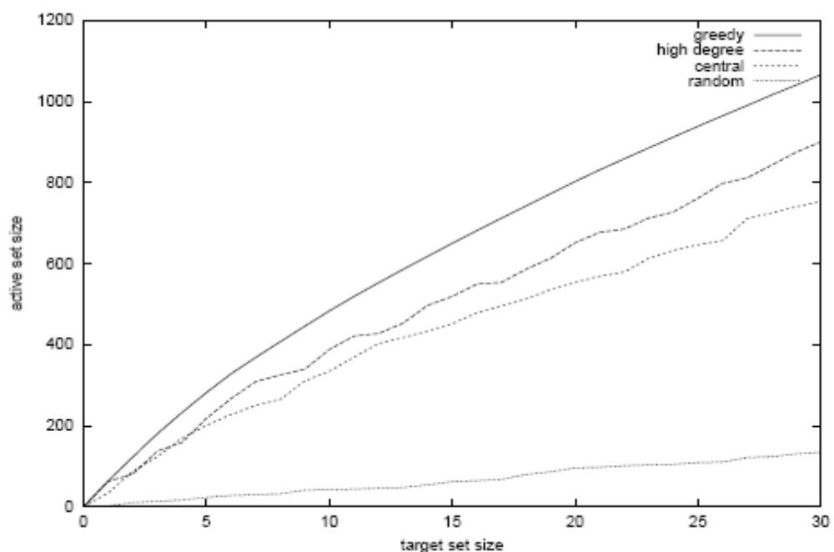
Results: linear threshold model
Notes:
The greedy algorithm outperforms the high-degree node heuristic by about 18%, and the central node
heuristic by over 40%. (As expected, choosing random nodes is
not a good idea.) This shows that significantly better marketing
results can be obtained by explicitly considering the dynamics of
information in a network, rather than relying solely on structural
properties of the graph.
When investigating the reason why the high-degree and centrality
heuristics do not perform as well, one sees that they ignore such
network effects. In particular, neither of the heuristics incorporates
the fact that many of the most central (or highest-degree) nodes
may be clustered, so that targeting all of them is unnecessary.

Slide 35
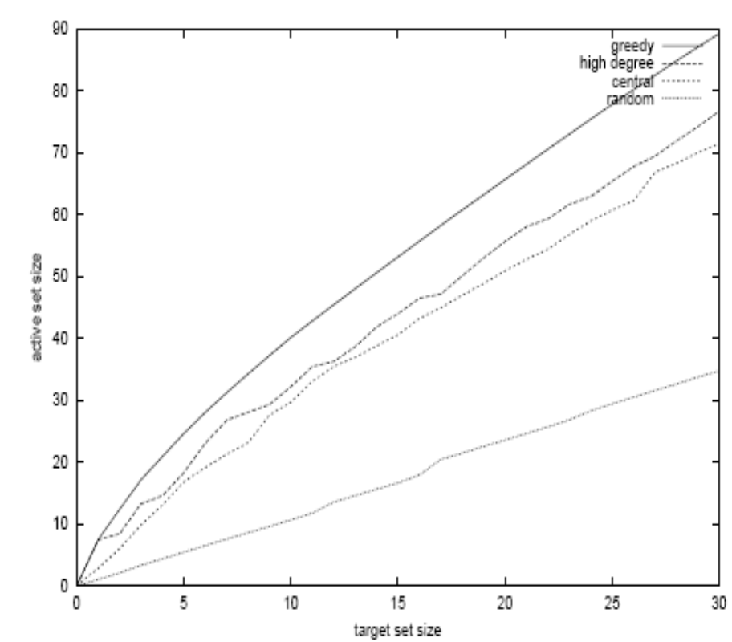
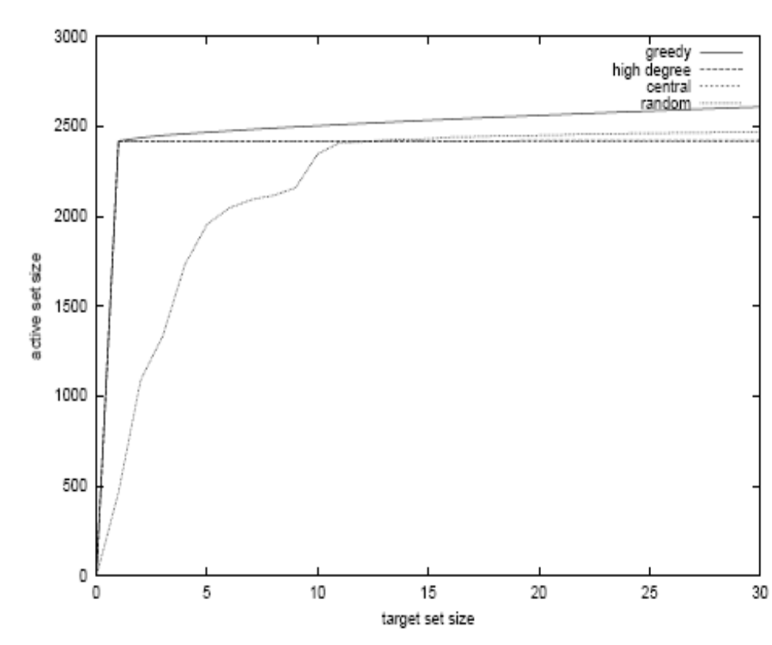
Independent Cascade Model – Case 1
P = 1%
P = 10%
Notes:
The graph for the independent cascade model with probability 1%, seems very similar to the previous two at
first glance. Notice, however, the very different scale: on average, each targeted node only activates three additional nodes. Hence, the network effects in the independent cascade model with very
small probabilities are much weaker than in the other models.
This suggests that the network effects observed for the linear threshold and weighted cascade models rely heavily on
low-degree nodes as multipliers, even though targeting high-degree nodes is a reasonable heuristic. Also notice that in the independent cascade model, the heuristic of choosing random nodes performs significantly better than in the previous two models.
The improvement in performance of the “random nodes” heuristic is even more pronounced for the independent cascade model with probabilities equal to 10%. In that model, it starts to outperform both the high-degree and the central nodes heuristics when more than 12 nodes are targeted. The first targeted node, if chosen somewhat judiciously, will activate a large fraction of the network, in our case almost 25%. However, any additional nodes will only reach a small additional fraction of the network. In particular, other central or high-degree nodes are very likely to be activated by the initially chosen one, and thus have hardly any marginal gain. This explains the shapes of the
curves for the high-degree and centrality heuristics, which leap up to about 2415 activated nodes, but make virtually no progress afterwards. The greedy algorithm, on the other hand, takes the effect of the first chosen node into account, and targets nodes with smaller marginal gain afterwards. Hence, its active set keeps growing, although
at a much smaller slope than in other models.

Slide 36
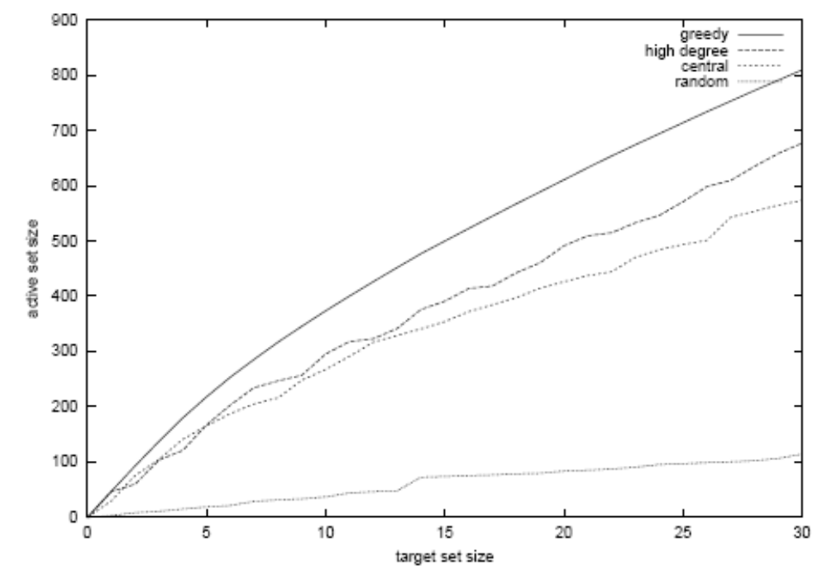
Independent Cascade Model – Case 2
Reminder: linear threshold model
Notes:
Notice the striking similarity to the linear threshold model; the scale
is slightly different (all values are about 25% smaller), but the
behavior is qualitatively the same, even with respect to the exact
nodes whose network influence is not reflected accurately by their
degree or centrality. The reason is that in expectation, each node is
influenced by the same number of other nodes in both models (see
Section 2), and the degrees are relatively concentrated around their
expectation of 1.

Slide 37
More in the Paper
A broader framework that simultaneously
generalizes the two models
Non-progressive process: active nodes CAN deactivate.
More realistic marketing:
  different marketing actions increase likelihood
  of initial activation, for several nodes at once.
Notes:
Our general framework has equivalent formulations in
terms of thresholds and cascades
We have thus far been concerned with the progressive case, in
which nodes only go from inactivity to activity, but not vice versa.
The non-progressive case, in which nodes can switch in both directions,
can in fact be reduced to the progressive case.
In the formulation of the problem, we have so far assumed that for one unit of budget, we can deterministically target any node v for activation. This is clearly a highly simplified view. In a more realistic scenario, we may have a number m of different marketing actions Mi available, each of which may affect some subset of nodes by increasing their probabilities of becoming active, without necessarily making them active deterministically. The more we
spend on any one action the stronger its effect will be; however, different nodes may respond to marketing actions in different ways

Slide 38
Open Questions
Study more general influence models. Find
trade-offs between generality and feasibility.
Deal with negative influences.
Model competing ideas.
Obtain more data about how activations occur
in real social networks.

Slide 40
Cascading Behavior in Large Blog Graphs
--Patterns and a model
Authors: Jure Leskovec, Mary McGlohon, Christos Faloutsos Natalie Glance, Matthew Hurst
Some slides borrowed from www.cs.cmu.edu/~mmcgloho/pubs/SandiaJuly2007.ppt, thanks to Mary

Slide 41
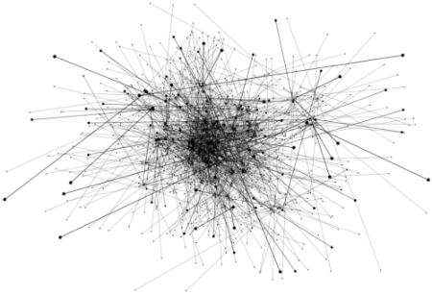
Introduction
Blog / 博客/ 部落格…
  an important medium of information
  a publicly available record of how information and influence spreads through a social network
Blogosphere: the collective term encompassing all blogs linked together forming as a community or social network.
Information Cascade: phenomena in which an idea becomes adopted due to influence by others

Slide 42
Research Questions
Temporal questions: How does popularity die off? Is there burstiness/periodicity?
Topological questions: What topological patterns do posts and blogs follow? What are the characteristic (size, shape, etc.) of a cascade?
Generative model: Can we build model that generate realistic cascades?

Slide 43
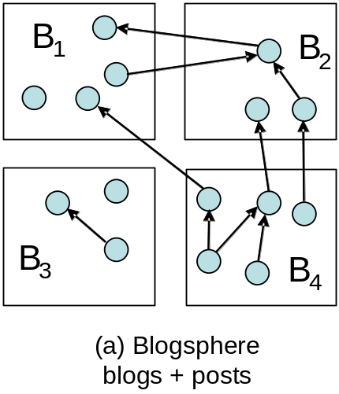
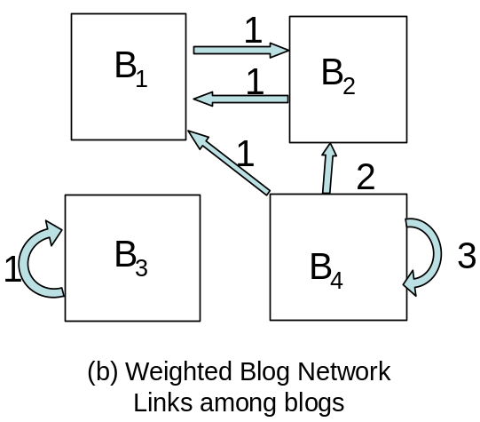
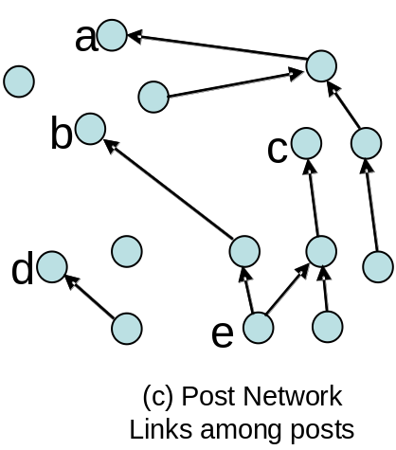
Preliminaries
Initiator (0 outlink)
Extracted (Nontrivial) Cascades: sub-graph induced by a time ordered propagation of information (edges)
b
c
d
a
Influence propagation
e
e
Notes:
Blogosphere is composed of blogs, which are further
composed of posts. Posts then contain links to other
posts and resources on the web.
From Blogosphere (a), we obtain the Blog network
(b) by collapsing all links between blog posts into
weighted edges between blogs. A directed blog-to-
blog edge is weighted with the total number of links
occurring between posts in source blog pointing to posts
in destination blog.
In contrast, to obtain the Post network (c), we
ignore the posts’ parent blogs and focus on the link
structure. Associated with each post is also the time
of the post, so we label the edges in Post network
with the time difference between the source and the
destination posts.
To extract a cascade we begin with an initiator
with no out-links to other posts, then add nodes with
edges linking to the initiator, and subsequently nodes
that link to any other member in the cascade.
Since a link points from the follow-up post to
the existing (older) post, influence propagates following
the reverse direction of the edges
We also define a non-trivial cascade to be a cascade
containing at least two posts, and therefore a trivial
cascade is an isolated post.

Slide 44
Blog Dataset
Constructed from another larger dataset *
45,000 blogs participating in cascades (biased towards the active part of the blogospher)
All their posts for 3 months (Aug-Sept ‘05)
2.4 million posts
~5 million links (245,404 inside the dataset)
*: N. S. Glance, M. Hurst, K. Nigam, M. Siegler,
R. Stockton, and T. Tomokiyo. Deriving marketing
intelligence from online discussion. In KDD, 2005.

Slide 45
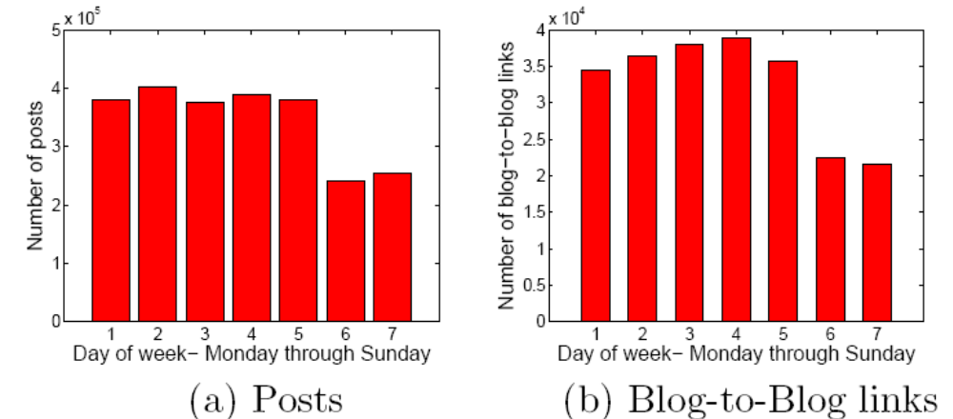
Temporal Observations
Is there periodicity in blog traffic?
  Yes. A week-end effect in both number of posts and number of links.
Notes:
Posting and blog-to-blog
linking patterns tend to have a weekend effect of sharply
dropping off at weekends.

Slide 46
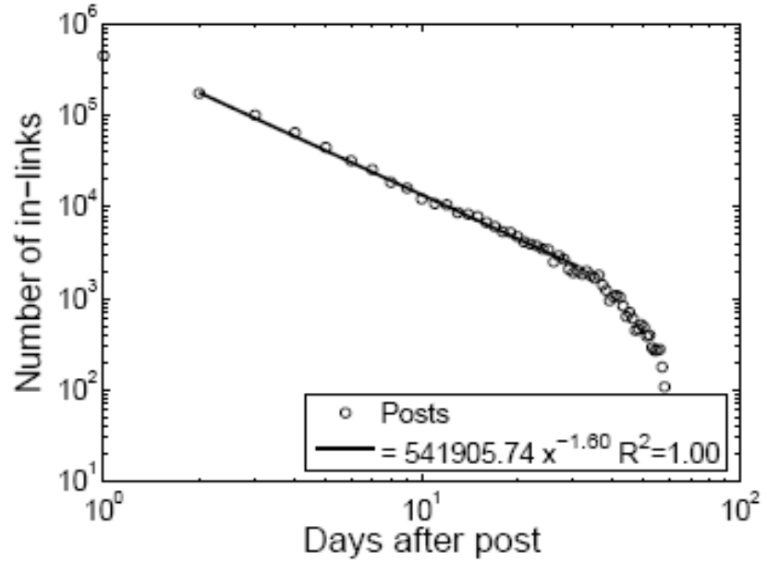
Temporal Observations
How does a post’s popularity grow over time?
  Post popularity drop-off follows a power law
The probability that a post written at time t_{p} acquires a link at time t_{p} + Δ is:
p(t_{p}+Δ) ∝ Δ^{-1.5}
Notes:
We fit the power-law distribution with a cut-off
in the tail (bottom row). We fit on 30 days of data,
since most posts in the graph have complete in-link
patterns for the 30 days following publication. We
performed the fitting over all posts and for all days
of the week separately, and found a stable power-law
exponent of around −1.5, which is exactly the value
predicted by the model where the bursty nature of
human behavior is a consequence of a decision based queuing process [4] – when individuals execute tasks
based on some perceived priority, the timing of the tasks
is heavy tailed, with most tasks being rapidly executed,
whereas a few experience very long waiting times.

Slide 47
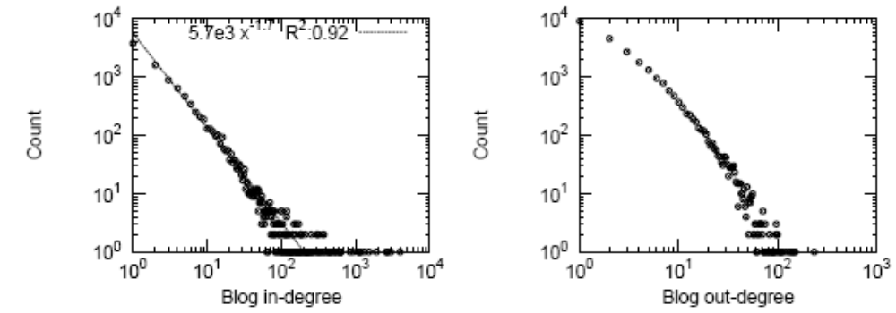
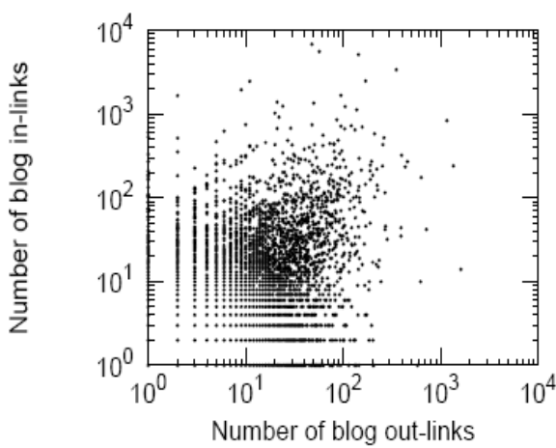
Topological Observations—Blog Network
Half of blogs belong to largest connected component
the other half are isolated
Both In- and out-degree follow (heavy tailed) power law distribution. In-degree exponent 1.7, out 3 (but they are NOT correlated– ρ = 0.16).
Strong rich-get-richer phenomena
Notes:
We fit the power-law distribution with a cut-off
in the tail (bottom row). We fit on 30 days of data,
since most posts in the graph have complete in-link
patterns for the 30 days following publication. We
performed the fitting over all posts and for all days
of the week separately, and found a stable power-law
exponent of around −1.5, which is exactly the value
predicted by the model where the bursty nature of
human behavior is a consequence of a decision based queuing process [4] – when individuals execute tasks
based on some perceived priority, the timing of the tasks
is heavy tailed, with most tasks being rapidly executed,
whereas a few experience very long waiting times.

Slide 48
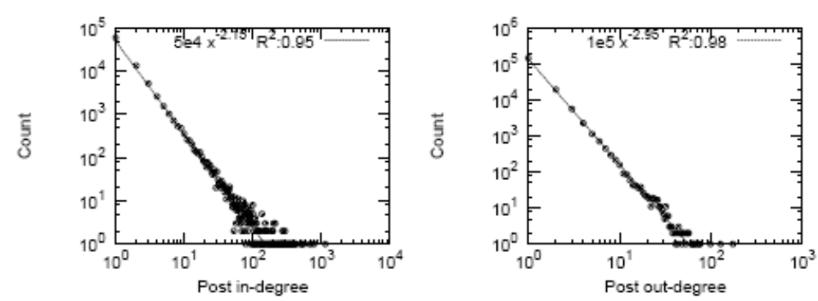
Topological Observations—Post Network
Very sparsely connected:2.2 million nodes and only 205, 000 edges
98% of the posts are isolated
In-degree and Out-degree follow power law with exponents −2.1 (In) and −2.9 (Out)

Slide 49

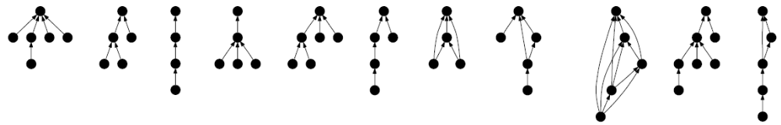
Topological Observations—Cascades
Cascade shapes (ordered by frequency)
Cascades are mostly tree-like, esp. stars
Interesting relation between the cascade frequency and structure
Notes:
We find the total of 2, 092, 418 cascades, and 97%
of them are trivial cascades (isolated posts), 1.8% are
smallest non-trivial cascades (G2), and the remaining
1.2% of the cascades are topologically more complex.
Also notice that cascade frequency rank does not simply decrease as a function of the cascade size. For example, as shown on Figure 9, a 4-star (G4) is more common than a chain of 3 nodes (G5). In general stars and shallow bursty
cascades are the most common type of cascades.
the number of edges e in the
cascade increases almost linearly with the number of
nodes n, the diameter increases
logarithmically with the size of the cascade: cascades are mostly tree-like structure:

Slide 50

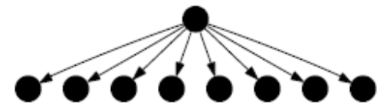
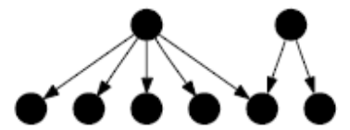
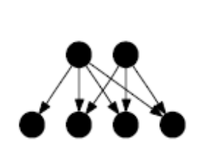

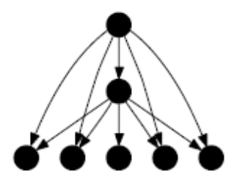
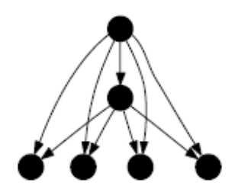

Compare—Viral cascade shapes
Stars (“no propagation”)
Bipartite cores (“common friends”)
Nodes having same friends

Slide 51
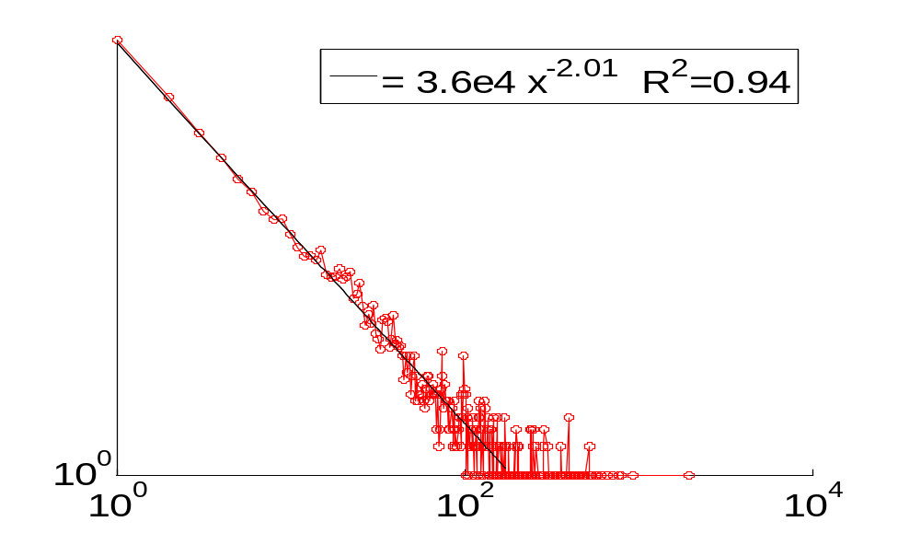
Topological Observations—Cascades
Cascade size: how many posts participate in cascades
Blog cascades tend to be larger than Viral Marketing cascades
The probability of observing a cascade on n nodes follows a Zipf distribution:
p(n) ∝ n⁻²
shallow drop-off
log count
some large cascades
log cascade size

Slide 52
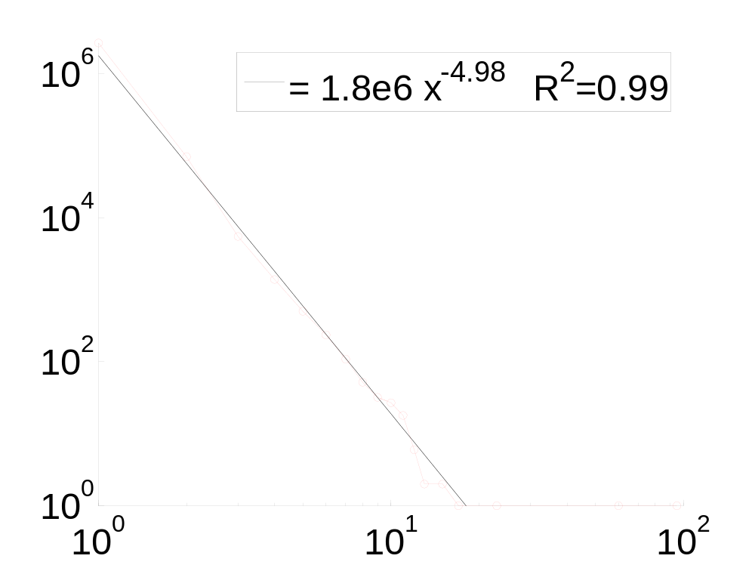
Compare—Viral cascade sizes
Count how many people are in a single cascade
steep drop-off
books
log count
very few large cascades
log cascade size

Slide 53
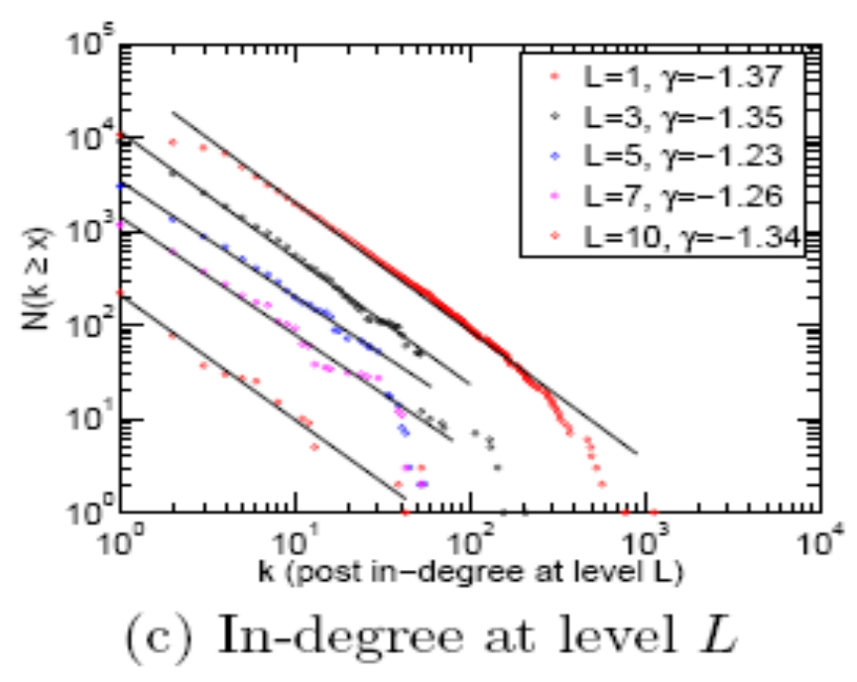
Topological Observations—Cascades
Also power laws in in/out-degree, size of different cascades (chains, stars) and degree per level.

Slide 54
A Generative Model
Model cascade generation as an epidemic
Use Simple virus propagation type of model (SIS)
  At any time, an entity is in one of two states: susceptible or infected.
  One parameter β determines how infectious the virus is.
Process
  Randomly pick blog u to be infected, and add it to cascade
  u infects each in-linked neighbor with probability β (∗)
  Add infected neighbors to cascade and link them to node u
  Set u to be not infected. Continue step (∗) until no nodes are infected.
Notes:
Every time a blog gets infected a new node is added to the cascade.
This accounts for multiple posts from the blog partici-
pating in the same cascade. Second, we note that in this
version of the model we do not try to account for topics
or model the influence of particular blogs. We assume
that all blogs and all conversations have the same value
of the parameter . Third, the process as describe above
generates cascades that are trees. This is not big limi-
tation since we observed that most of the cascades are
trees or tree-like. In the spirit of our notion of cascade
we assume that cascades have a single starting point,
and do not model for the collisions of the cascades.

Slide 55

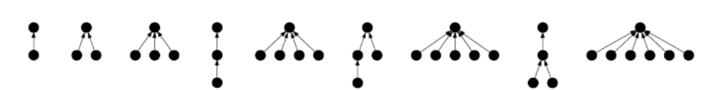
A Generative Model—Validation
10 simulations, 2 million cascades each time (β=.025)
Top 10 (9?) most frequent cascades: 7 are matched exactly
Model generated:
Real:
Notes:
We validate our model by extensive numerical simulations. We com-
pare the obtained cascades towards the real cascades ex-
tracted from the Post network. We find that the model
matches the cascade size and degree distributions.

Slide 56
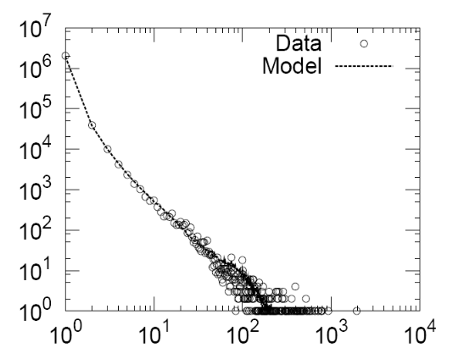
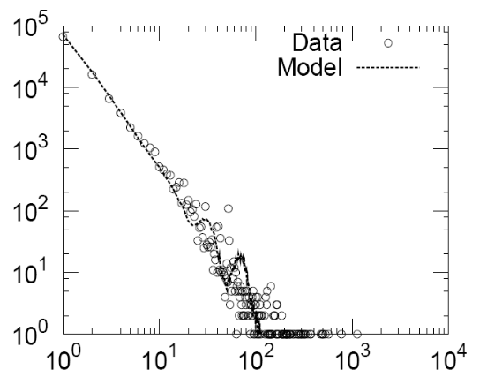
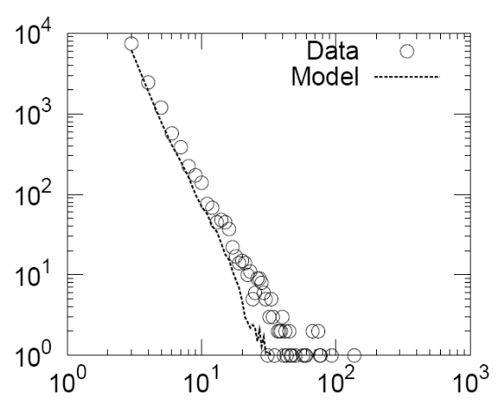
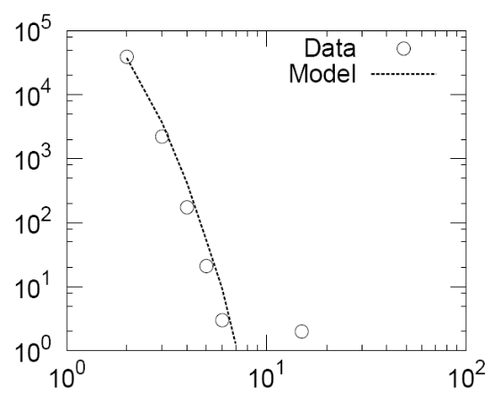
A Generative Model—Validation
matching cascade size and in-degree distributions (out-degree ≡ 1)
Generally good agreement
Count
Count
Cascade size
Cascade node in-degree
Count
Count
Size of star cascade
Size of chain cascade
Notes:
We validate our model by extensive numerical simulations. We com-
pare the obtained cascades towards the real cascades ex-
tracted from the Post network. We find that the model
matches the cascade size and degree distributions.

Slide 57
Conclusions
Temporal Properties
  Popularity drop-off follows power-law distribution exactly as found in other work about human response times.
  Posts follow weekly periodicity.
Topological Properties
  Power law distributions in almost every topological property. Star cascades are more common than chains, and size of cascades follow a power law.
Generative Model
  Developed a generative model based on SIS model in epidemiology that matched properties of cascades.

Slide 58
Thanks!

